Slide 1

World Space Week 2024
ZERO BANK GRAVITY
Presented by;
M. Hassan Gul (B-7231)
Ahmad Bajwa (B-10693)
Siddeeq Public School

Slide 2
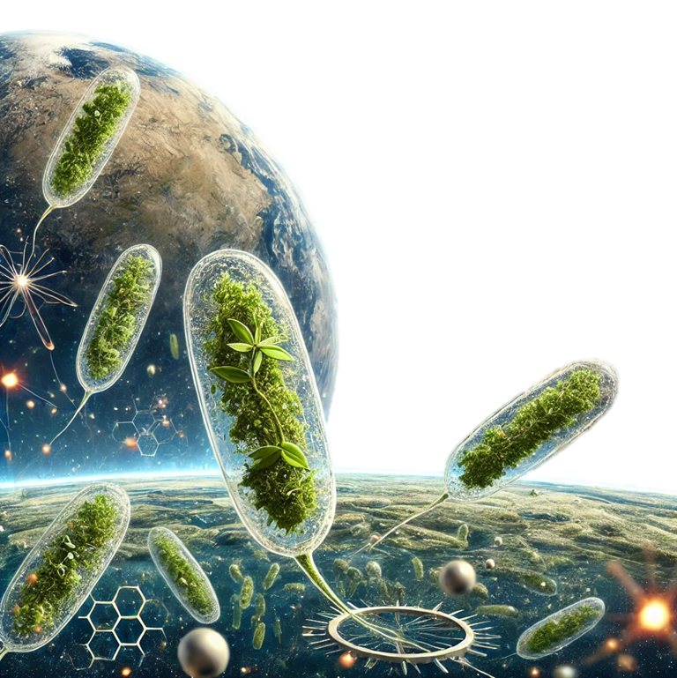
Introduction
Phytoplankton are microscopic marine organisms essential for carbon cycling, as they absorb large amounts of CO2 through photosynthesis. This process, called carbon sequestration, is critical for regulating Earth’s climate.
However, how these organisms function in space, especially under microgravity, remains unexplored.
Space-based research offers a unique opportunity to analyze their growth and behavior in conditions unachievable on Earth.

Slide 3
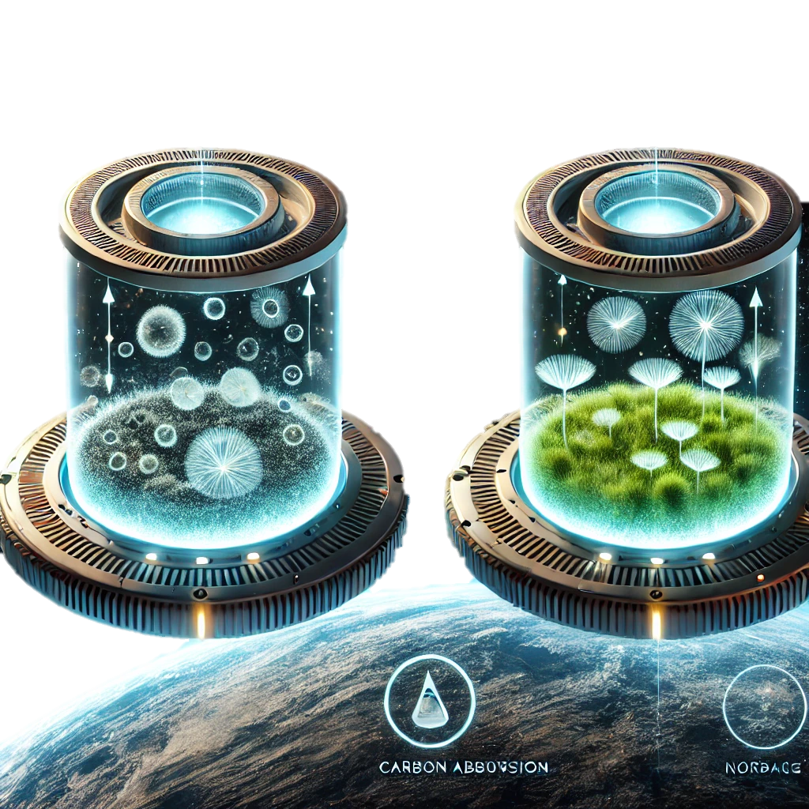
Objectives
This experiment investigates:
Influence of microgravity on phytoplankton’s growth and distribution.
The impact of varying CO2 levels on their carbon absorption rates in space.
The potential of ISS-based research to enhance our understanding of oceanic carbon sequestration, improving climate models and policy strategies on Earth.

Slide 4
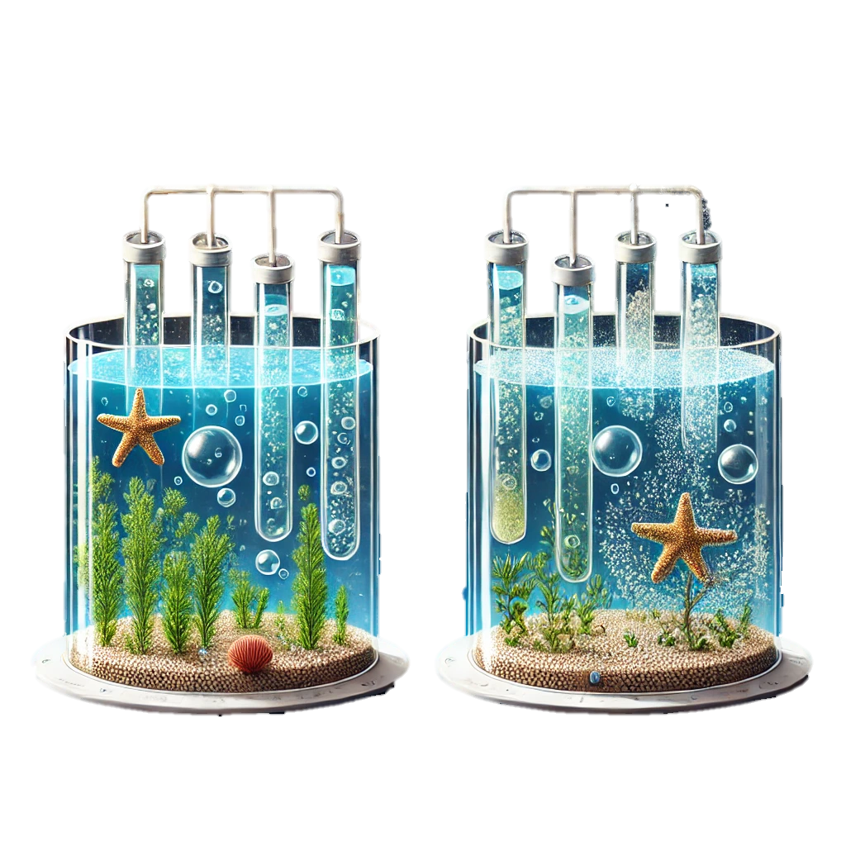
Experiment Design
Growth Chambers:
Cultivate phytoplankton in sealed chambers
Simulate ocean conditions (nutrients, light)
Control CO2 levels to test different scenarios
Microgravity Impact:
Analyze phytoplankton behavior under microgravity.
Compare with Earth-based controls.

Slide 5
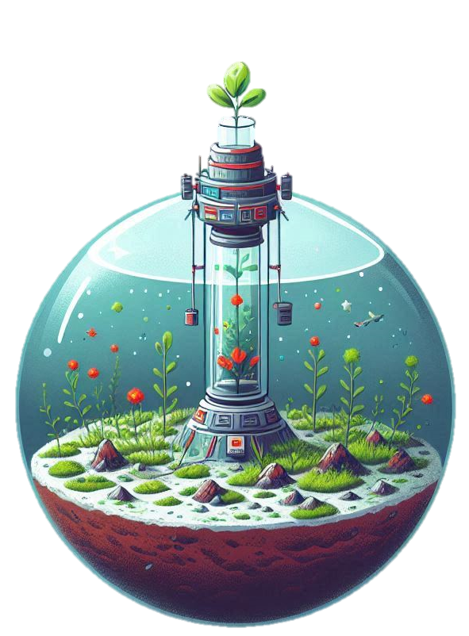
Experiment Design
Measurements:
Using sensors for tracking photosynthesis, growth and carbon absorption rates
Monitoring gas exchange and photosynthesis efficiency
Data Collection:
Gathering data on phytoplankton's carbon sequestration potential in space
Comparing space results to Earth’s conditions

Slide 6

Analyzing Ocean Carbon Sequestration
ISS’s Unique Vantage Point
Observes Earth’s oceans from space
Monitors phytoplankton blooms via satellite imagery and sensors.
Refining Carbon Sequestration Estimation
Focus on phytoplankton’s role in absorbing atmospheric CO2.
Combining Space Data with Experiment
Space observations integrated with experimental results.
Development of more accurate global climate models.

Slide 7
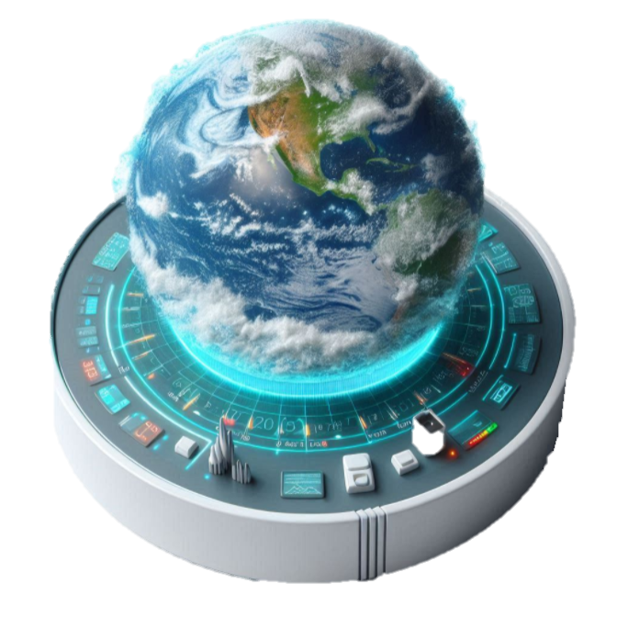
Expected Changes in Phytoplankton under Microgravity
Increased Nutrient Availability
Enhanced Water Circulation
Improved Light Penetration
Altered Cell Membrane Permeability
Changes in Phytoplankton Orientation
Reduced Gravitational Stress
Increased Cell Division Rate

Slide 8
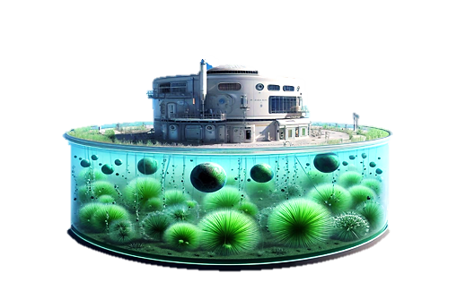
Expected Outcomes
The experiment is expected to show how microgravity and CO₂ variations affect the growth and carbon sequestration capacity of phytoplankton. This could lead to:
New insights into phytoplankton behavior in space and extreme conditions.
Enhanced accuracy in predicting oceanic carbon sequestration.
Improved climate models incorporating these findings for better global climate predictions.

Slide 9
Expected Analysis
Normal Conditions
Ideal Conditions
Graph comparing the Carbon Consumption rate of phytoplankton on Earth versus in zero gravity
Graph comparing the doubling rate of phytoplankton on Earth versus in zero gravity

Slide 10
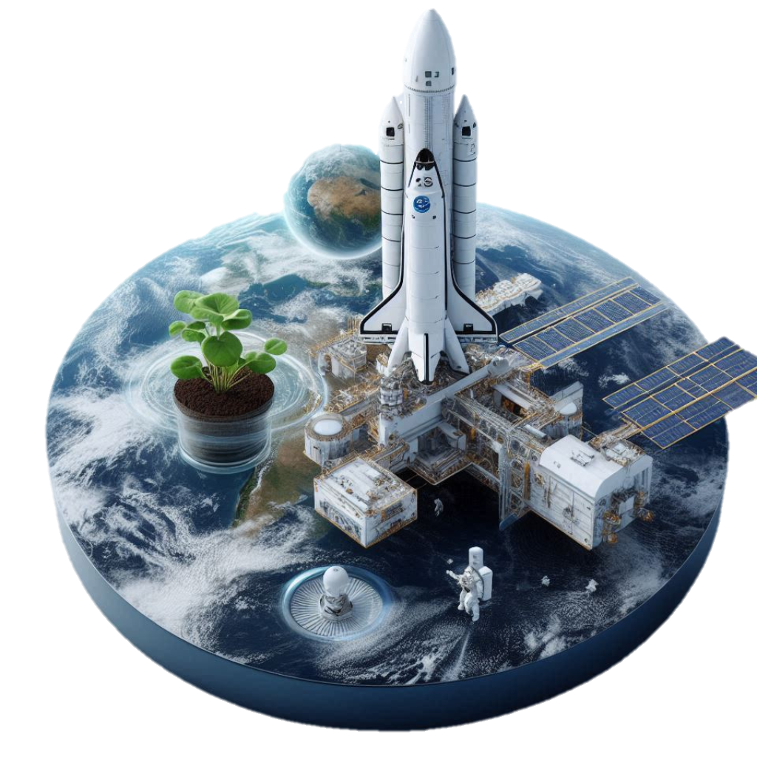
Potential Benefits
This experiment will contribute to climate action by providing valuable data on the oceans' role in mitigating climate change.
Understanding how space-based conditions impact phytoplankton growth will help refine carbon removal technologies and global climate strategies.
The ISS’s unique vantage point will also improve satellite-based climate monitoring systems, giving scientists and policymakers real-time, accurate data for better-informed decisions.

Slide 11


